Slide 1

PPLM – Pluggable Playable Language Model
DS8008 - Natural Language Processing
Subramanian Kaushik Gurumoorthy (2021)

Slide 2


Controllable Language Generation
Training large conditional model from scratch
Fine tune a pre-trained model to produce text with specific attribute
Changing text generated in post processing manner against a target attribute
All these approaches required effort to retrain the model or a trade off in text generated quality or using existing unconditional language models
How to change the topic or sentiment of above text generation ?
GPT -2 - Medium
The Food is awful.
The staff are rude
and lazy. The food is
disgusting – even by
my standards
The Food
is awful
Notes:
Notes to presenter:
Description of what you learned in your own words on one side.
Include information about the topic
Details about the topic will also be helpful here.
Tell the story of your learning experience. Just like a story there should always be a beginning, middle and an end.
On the other side, you can add a graphic that provides evidence of what you learned.
Feel free to use more than one slide to reflect upon your process. It also helps to add some video of your process.

Slide 3
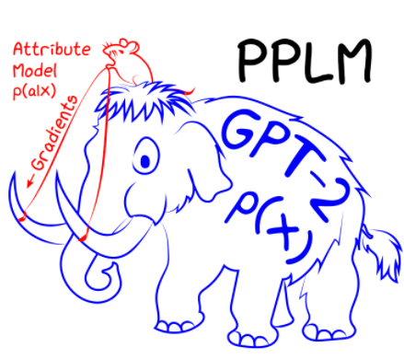

PPLM to rescue
PPLM = GPT2 (p(x)) + Attribute model p(a|x)
Pre trained language model p(x)
Use an additional attribute model which would update the weights as per the desired target attribute p(a|x) i.e. topics and Sentiments
Target – Conditional language model p(x|a)
Sampling using approximate metropolis-adjusted langevin approach
Notes:
Notes to presenter:
Description of what you learned in your own words on one side.
Include information about the topic
Details about the topic will also be helpful here.
Tell the story of your learning experience. Just like a story there should always be a beginning, middle and an end.
On the other side, you can add a graphic that provides evidence of what you learned.
Feel free to use more than one slide to reflect upon your process. It also helps to add some video of your process.

Slide 4
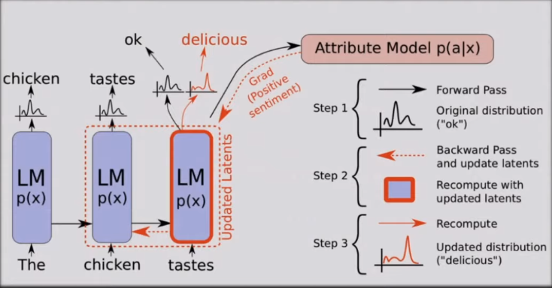
PPLM – “U” Turn your car
Notes:
Notes to presenter:
Description of what you learned in your own words on one side.
Include information about the topic
Details about the topic will also be helpful here.
Tell the story of your learning experience. Just like a story there should always be a beginning, middle and an end.
On the other side, you can add a graphic that provides evidence of what you learned.
Feel free to use more than one slide to reflect upon your process. It also helps to add some video of your process.

Slide 5
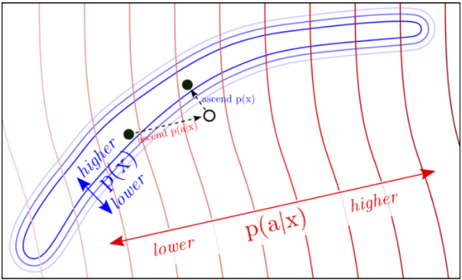
PPLM – How to ensure fluency ?
Only considering the attribute model, we would end up in unrealistic examples “great great great great”
How ?
Minimizing KL divergence between controlled and uncontrolled LM
Performing post norm fusion between the modified and unmodified next word distributions
Why we do it ?
Increase p (a|x)
Notes:
Notes to presenter:
Description of what you learned in your own words on one side.
Include information about the topic
Details about the topic will also be helpful here.
Tell the story of your learning experience. Just like a story there should always be a beginning, middle and an end.
On the other side, you can add a graphic that provides evidence of what you learned.
Feel free to use more than one slide to reflect upon your process. It also helps to add some video of your process.

Slide 6
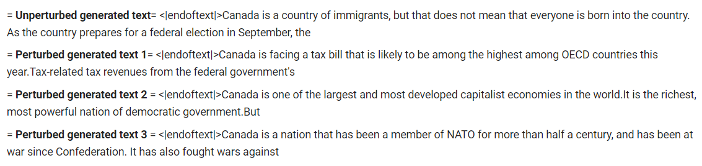
Results
Topic – Politics– Sentiment -Positive
Notes:
Notes to presenter:
Description of what you learned in your own words on one side.
Include information about the topic
Details about the topic will also be helpful here.
Tell the story of your learning experience. Just like a story there should always be a beginning, middle and an end.
On the other side, you can add a graphic that provides evidence of what you learned.
Feel free to use more than one slide to reflect upon your process. It also helps to add some video of your process.

Slide 7
Hyper parameters – The Gears
bag_of_words (science, politics, religion, legal, military, space, technology)
length Length of generated text
gm_scale Fluency factor
kl_scale Fluency factor
class_label 3- Negative , 2 – Positive
Stepsize To intensify topic control & decrease value to soften the control
Notes:
Notes to presenter:
Description of what you learned in your own words on one side.
Include information about the topic
Details about the topic will also be helpful here.
Tell the story of your learning experience. Just like a story there should always be a beginning, middle and an end.
On the other side, you can add a graphic that provides evidence of what you learned.
Feel free to use more than one slide to reflect upon your process. It also helps to add some video of your process.

Slide 8
Summary
PPLM can be thought of as a generic machine for flipping literary critic models p(a|x) that can judge the worthiness of text they read into author models p(x|a) that can write something similarly worthy
A simple Plug and play approach to controlled text generation without fine tuning the LM or training a controlled LM from scratch
Two tiny attribute models BOW for topic and a sentiment discriminator to steer
Notes:
Notes to presenter:
Description of what you learned in your own words on one side.
Include information about the topic
Details about the topic will also be helpful here.
Tell the story of your learning experience. Just like a story there should always be a beginning, middle and an end.
On the other side, you can add a graphic that provides evidence of what you learned.
Feel free to use more than one slide to reflect upon your process. It also helps to add some video of your process.

Slide 9
Thank You
References
Controlling Text Generation with Plug and Play Language Models | Uber Engineering Blog
[1912.02164] Plug and Play Language Models: A Simple Approach to Controlled Text Generation (arxiv.org)
Authors
Sumanth Dathathri, Andrea Madotto, Janice Lan, Jane Hung, Eric Frank, Piero Molino, Jason Yosinski, Rosanne Liu
Useful links
"Plug & Play Generative Networks: Conditional Iterative Generation of Images in Latent Space“
(527) Plug and Play Language Models: A Simple Approach to Controlled Text Generation | AISC – YouTube
Notes:
Notes to presenter:
Description of what you learned in your own words on one side.
Include information about the topic
Details about the topic will also be helpful here.
Tell the story of your learning experience. Just like a story there should always be a beginning, middle and an end.
On the other side, you can add a graphic that provides evidence of what you learned.
Feel free to use more than one slide to reflect upon your process. It also helps to add some video of your process.

